Slide 1
AYH MART: Checkout System

Slide 2

A Project On
AYH MART - Checkout System
Inclusive Integrated | Innovative
Programme
IMCA I Sem-2
Under the Guidance of
Prof. Veer Pachchigar
Presented By
Aum - ET25IMCA039
Yesh - ET25IMCA044
HariKrushna - ET25IMCA008

Slide 3
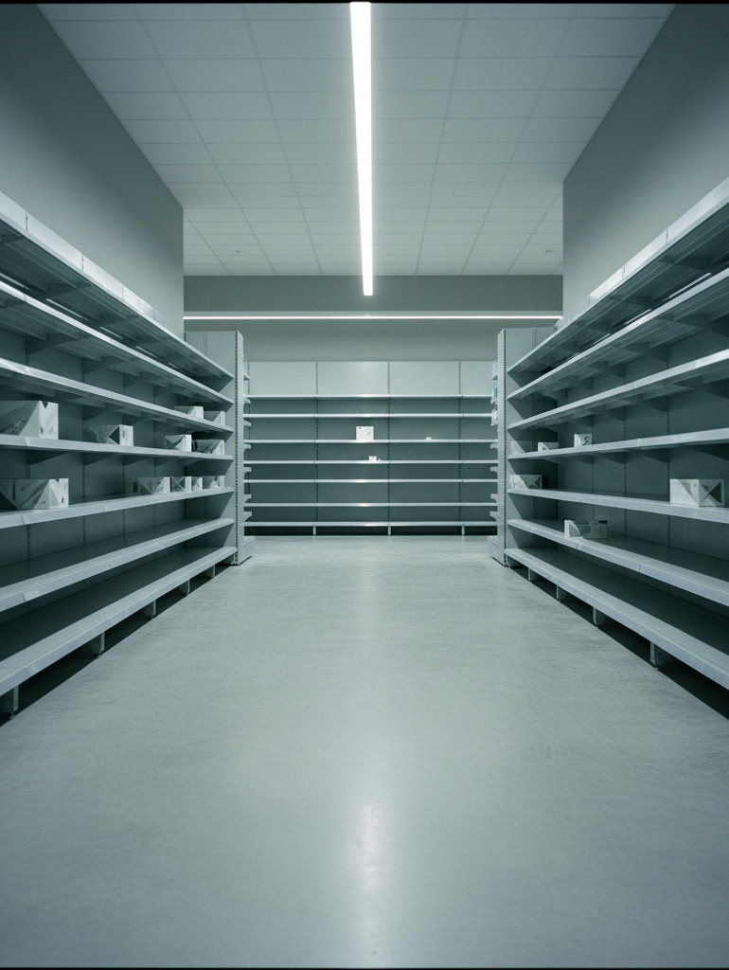
What we'll cover
Agenda
Project Abstract
Objective
System Description
Screenshots
Test Cases
References

Slide 4


Project abstract
AYH Mart self checkout system
AYH Mart is a console-based self checkout system developed in C, designed for a retail store in Surat, India. It allows customers to independently browse products, add items to a cart, and complete purchases via Cash or UPI QR Code payment.
The system supports three user roles - Customer, Staff, and Admin - each with a dedicated portal. Key features include product inventory management, a tiered membership discount program (Silver, Gold, Platinum), customer account management, and a detailed sales reporting module.
All data is managed in-memory using C structures, making the system lightweight, efficient, and fully functional as a retail management solution.

Slide 5
Project objectives
C-based system
Functional self-checkout system built in C for a real retail environment.
Role-based access
Separate access levels for Admin, Staff, and Customer users.
Inventory management
Add, Edit, Delete, and View products with cart and stock deduction.
Tiered membership
Silver (5%), Gold (10%), and Platinum (15%) discount tiers for members.
Dual payment
Cash with change calculation and UPI QR Code payment support.
Sales reports
Revenue, discount, and product-wise reports with structured data records.

Slide 6
System description
Languages, libraries, data structures and architecture
Language & Platform
C (Standard C)
Windows Console App
GCC / MinGW / Dev-C++ / Code::Blocks
Libraries used
stdio.h — I/O operations
string.h — String handling
ctype.h — Char classification
stdlib.h — System calls, exit()
windows.h — UTF-8 / Unicode support
Architecture ​Menu-driven, modular function design. ​
5 core modules:
Inventory
Members
Customer Self-Checkout
Sales Reports
Customer Accounts
Data structures (structs)
Product ​ ​pCode | pName | pPrice |
pStock | pCategory
Member ​ ​mId | mName | mSpent |
mTier | mDisc | mUsed
CartItem ​ ​code | name | price | qty
Sale & Customer ​ ​Sale: pCode | pName | qty | price | total
​Customer: cId | cName | cPass | cMemberId

Slide 7
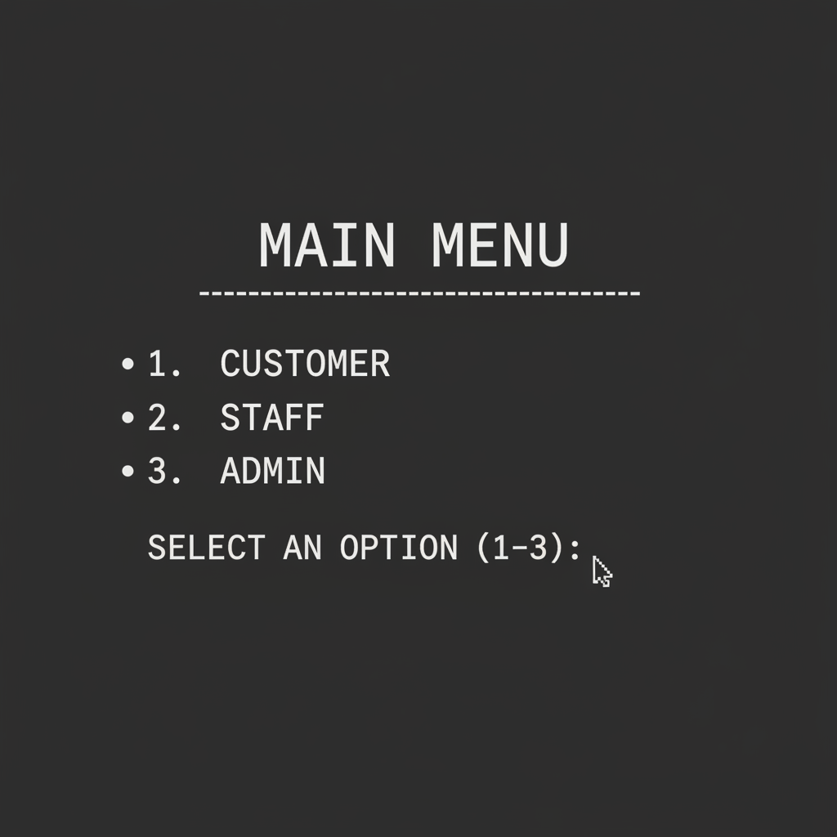
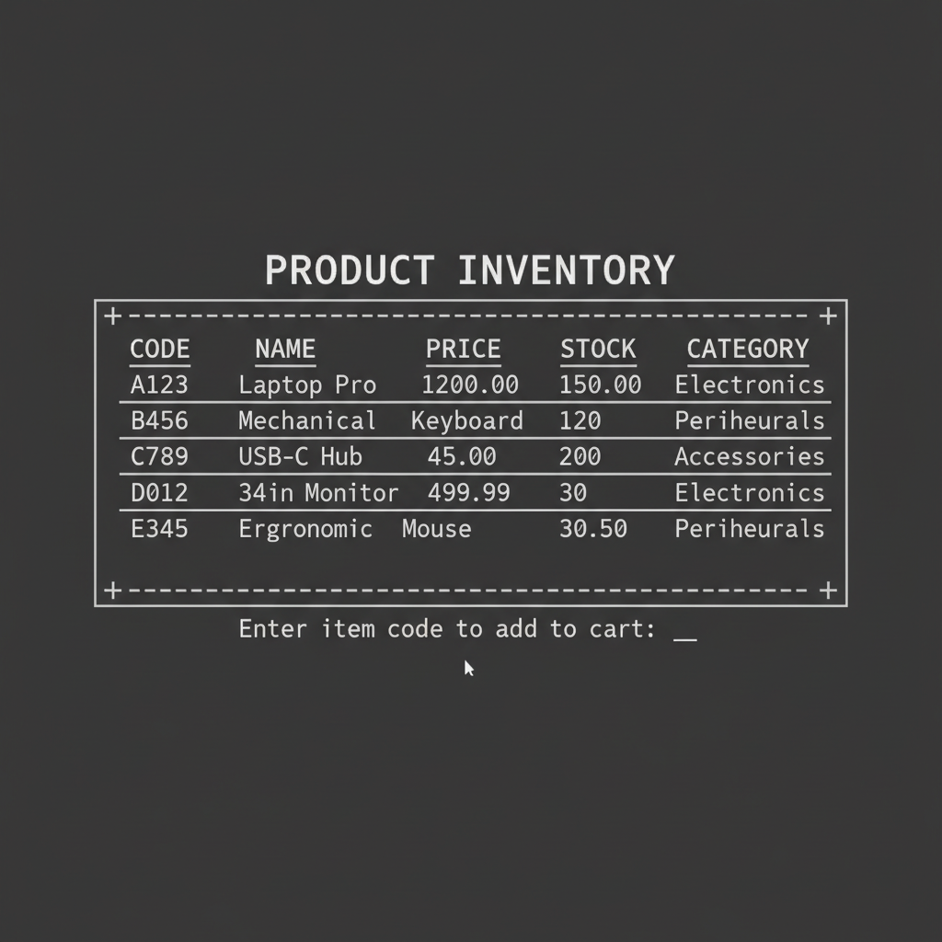
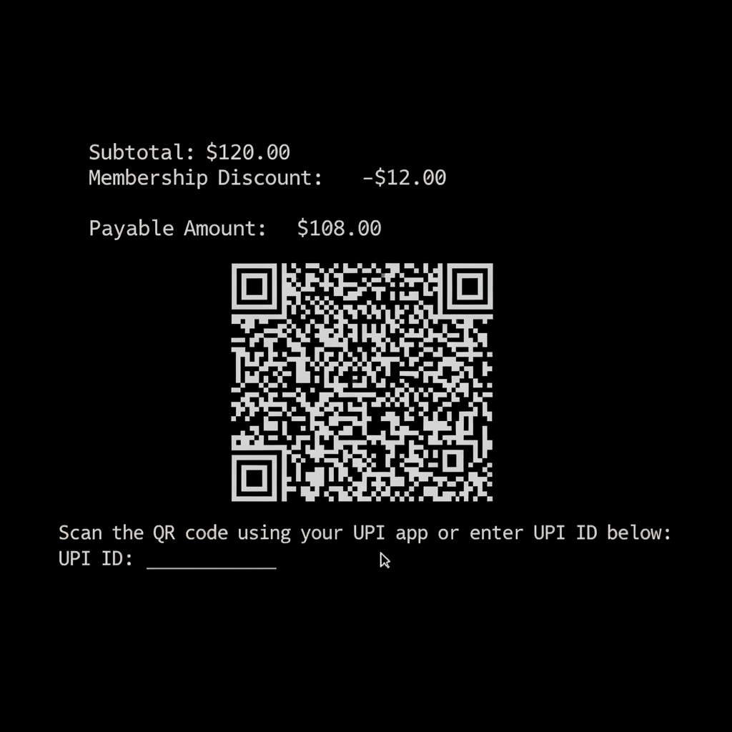
Screenshots
Main menu and login
Product and cart flow
Checkout and payment
Role selection: Customer, Staff, Admin
Customer login and self-checkout menu
Product list: Code, Name, Price, Stock
Add to cart and Admin inventory table
Subtotal, discount, payable amount
QR code UPI payment and sales report

Slide 8
Test cases
All 12 test cases passed. AYH MART Self Checkout System - functional validation results.
#
Test Case
Input
Expected Output
Result
01
Customer login - valid
Correct ID and password
"Welcome, Name!"
Pass
02
Customer login - invalid
Wrong ID or password
Invalid Customer ID or Password
Pass
03
Add to cart - valid product
Correct code, qty ≤ stock
Item added to basket
Pass
04
Add to cart - insufficient stock
qty > available stock
Insufficient stock warning
Pass
05
Membership discount - valid
Member ID with active card
Discount applied, card marked Used
Pass

Slide 9
#
Test Case
Input
Expected Output
Result
06
Membership discount - used card
Member ID with used card
Card already used. No discount.
Pass
07
Cash payment - sufficient
Amount ≥ payable
Change returned, bill printed
Pass
08
Cash payment - insufficient
Amount < payable
Need X more prompt
Pass
09
QR Code payment
Select QR option
QR displayed, Transaction ID generated
Pass
10
Admin delete product - valid
Valid product code
Product deleted successfully
Pass
11
Admin delete product - invalid
Invalid product code
Product code not found
Pass
12
Sales summary report
After 2 transactions
Correct bills, revenue, discounts shown
Pass

Slide 10

Refer​ences

Slide 11


Thank You
AYH MART
Checkout System
AYH MART - Self Checkout System Presentation

